Slide 1
Introduction to Machine Learning and Data Mining (Học máy và Khai phá dữ liệu)
Khoat Than
School of Information and Communication Technology
Hanoi University of Science and Technology

Slide 2
Contents
Introduction to Machine Learning & Data Mining
Supervised learning
Linear regression
Unsupervised learning
Practical advice

Slide 3
Linear regression: introduction
Regression problem: learn a function y = f(x) from a given training data D = {(x₁, y₁), (x₂, y₂), …, (x_{M}, y_{M})} such that y_{i} ≅ f(x_{i}) for every i
Each observation of x is represented by a vector in an n-dimensional space, e.g., x_{i} = (x_{i1}, x_{i2}, …, x_{in})^{T}. Each dimension represents an attribute/feature/variate.
Bold characters denote vectors.
Linear model: if f(x) is assumed to be of linear form
f(x) = w₀ + w₁x₁ + … + w_{n}x_{n}
w₀, w₁, …, w_{n} are the regression coefficients/weights. w₀ sometimes is called “bias”.
Note: learning a linear model is equivalent to learning the coefficient vector w = (w₀, w₁, …, w_{n})^{T}.

Slide 4
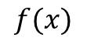
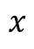
Linear regression: example
What is the best function?
x | y
0.13 | -0.91
1.02 | -0.17
3.17 | 1.61
-2.76 | -3.31
1.44 | 0.18
5.28 | 3.36
-1.74 | -2.46
7.93 | 5.56
... | ...
$$f(x)$$
$$x$$

Slide 5
Prediction
For each observation x = (x₁, x₂, …, x_{n})^{T}
The true output: c_{x} (but unknown for future data)
Prediction by our model:
y_{x} = w₀ + w₁x₁ + … + w_{n}x_{n}
We often expect y_{x} ≅ c_{x}.
Prediction for a future observation z = (z₁, z₂, …, z_{n})^{T}
Use the learned function to make prediction
f(z) = w₀ + w₁z₁ + … + w_{n}z_{n}

Slide 6
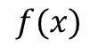
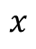
Learning a regression function
Learning goal: learn a function f* such that its prediction in the future is the best.
Its generalization is the best.
Difficulty: infinite number of functions
How can we learn?
Is function f better than g?
Use a measure
Loss function is often used to guide learning.
$$f(x)$$
$$x$$

Slide 7
Loss function
Definition:
The error/loss of the prediction for an observation x = (x₁, x₂, …, x_{n})^{T}
r(x) = [c_{x} – f(x)]² = (c_{x} – w₀ – w₁x₁ -… - w_{n}x_{n})²
The expected loss of f over the whole space:
E = E_{x}[r(x)] = E_{x}[c_{x} – f(x)]²
(E_{x} is the expectation over x)
The goal of learning is to find f* that minimizes the expected loss:
H is the space of functions of linear form.
But, we cannot work directly with this problem during the learning phase. (why?)
Cost, risk

Slide 8
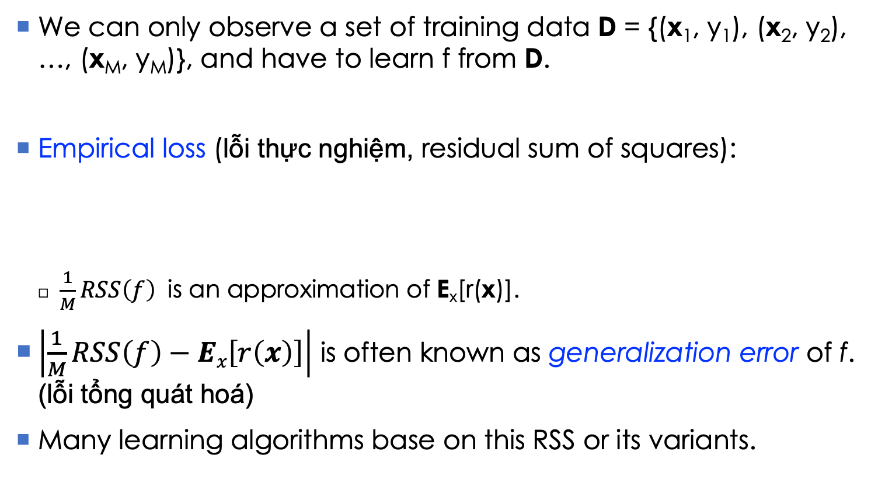
Empirical loss
We can only observe a set of training data D = {(x₁, y₁), (x₂, y₂), …, (x_{M}, y_{M})}, and have to learn f from D.
Empirical loss (lỗi thực nghiệm, residual sum of squares):
$\frac{1}{M}RSS\left(f\right)$ is an approximation of E_{x}[r(x)].
$\left|\frac{1}{M}RSS\left(f\right)−Ex\left[r\left(x\right)\right]\right|$ is often known as generalization error of f. (lỗi tổng quát hoá)
Many learning algorithms base on this RSS or its variants.

Slide 9
Methods: ordinary least squares (OLS)
Given D, we find f* that minimizes RSS:
This method is often known as ordinary least squares (OLS, bình phương tối thiểu).
Find w* by taking the gradient of RSS and the solving the equation RSS’=0. We have:
Where A is the data matrix of size Mx(n+1), whose the i^{th} row is A_{i} = (1, x_{i1}, x_{i2}, …, x_{in}); B⁻¹ is the inversion of matrix B; y = (y₁, y₂, …, y_{M})^{T}.
Note: we assume that A^{T}A is invertible (ma trận A^{T}A khả nghịch).
(1)

Slide 10
Methods: OLS
Input: D = {(x₁, y₁), (x₂, y₂), …, (x_{M}, y_{M})}
Output: w*
Learning: compute
Where A is the data matrix of size Mx(n+1), whose the i^{th} row is A_{i} = (1, x_{i1}, x_{i2}, …, x_{in}); B⁻¹ is the inversion of matrix B; y = (y₁, y₂, …, y_{M})^{T}.
Note: we assume that A^{T}A is invertible.
Prediction for a new x:

Slide 11
Methods: OLS example
x | y
0.13 | -1
1.02 | -0.17
3 | 1.61
-2.5 | -2
1.44 | 0.1
5 | 3.36
-1.74 | -2.46
7.5 | 5.56
f*
f*(x) = 0.81x – 0.78

Slide 12
Methods: limitations of OLS
OLS cannot work if A^{T}A is not invertible
If some columns (attributes/features) of A are dependent, then A will be singular and therefore A^{T}A is not invertible. (Nếu một vài cột của A phụ thuộc tuyến tính thì A sẽ không khả nghịch)
OLS requires considerable computation due to the need of computing a matrix inversion.
Intractable for the very high dimensional problems.
OLS likely tends to overfitting, because the learning phase just focuses on minimizing the error of the training data.

Slide 13

Methods: Ridge regression (1)
Given D = {(x₁, y₁), (x₂, y₂), …, (x_{M}, y_{M})}, we solve for:
Where A_{i} = (1, x_{i1}, x_{i2}, …, x_{in}) is composed from x_{i}; and λ is a regularization constant (λ> 0). ${\left\|w\right\|}_{2}$ is the L² norm.
(2)

Slide 14
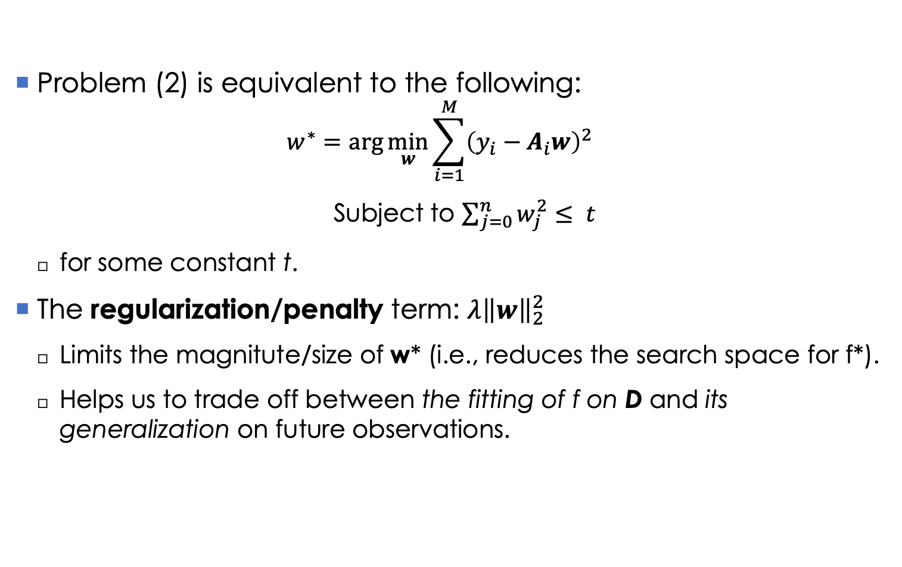
Methods: Ridge regression (2)
Problem (2) is equivalent to the following:
$$w^{∗}=\arg{\min_{w}{\sum_{i=1}^{M}{{\left(y_{i}−A_{i}w\right)}^{2}}}}$$
Subject to $\sum_{j=0}^{n}{w_{j}^{2}}≤ t$
for some constant t.
The regularization/penalty term: $λ{\left\|w\right\|}_{2}^{2}$
Limits the magnitute/size of w* (i.e., reduces the search space for f*).
Helps us to trade off between the fitting of f on D and its generalization on future observations.
(3)

Slide 15
Methods: Ridge regression (3)
We solve for w* by taking the gradient of the objective function in (2), and then zeroing it. Therefore we obtain:
Where A is the data matrix of size Mx(n+1), whose the i^{th} row is A_{i} = (1, x_{i1}, x_{i2}, …, x_{in}); B⁻¹ is the inversion of matrix B; y = (y₁, y₂, …, y_{M})^{T}; I_{n+1} is the identity matrix of size n+1.
Compared with OLS, Ridge can
Avoid the cases of singularity, unlike OLS. Hence Ridge always works.
Reduce overfitting.
But error in the training data might be greater than OLS.
Note: the predictiveness of Ridge depends heavily on the choice of the hyperparameter λ.

Slide 16
Methods: Ridge regression (4)
Input: D = {(x₁, y₁), (x₂, y₂), …, (x_{M}, y_{M})} and λ>0
Output: w*
Learning: compute
Prediction for a new x:
Note: to avoid some negative effects of the magnitute of y on covariates x, one should remove w₀ from the penalty term in (2). In this case, the solution of w* should be modified slightly.

Slide 17
An example of using Ridge and OLS
The training set D contains 67 observations on prostate cancer, each was represented with 8 attributes. Ridge and OLS were learned from D, and then predicted 30 new observations.
w | Ordinary Least Squares | Ridge
0 | 2.465 | 2.452
lcavol | 0.680 | 0.420
lweight | 0.263 | 0.238
age | −0.141 | −0.046
lbph | 0.210 | 0.162
svi | 0.305 | 0.227
lcp | −0.288 | 0.000
gleason | −0.021 | 0.040
pgg45 | 0.267 | 0.133
Test RSS | 0.521 | 0.492

Slide 18
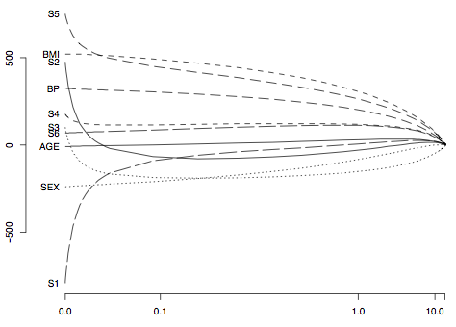
Effects of λ in Ridge regression
W* = (w₀, S1, S2, S3, S4, S5, S6, AGE, SEX, BMI, BP) changes as the regularization constant λ changes.

Slide 19
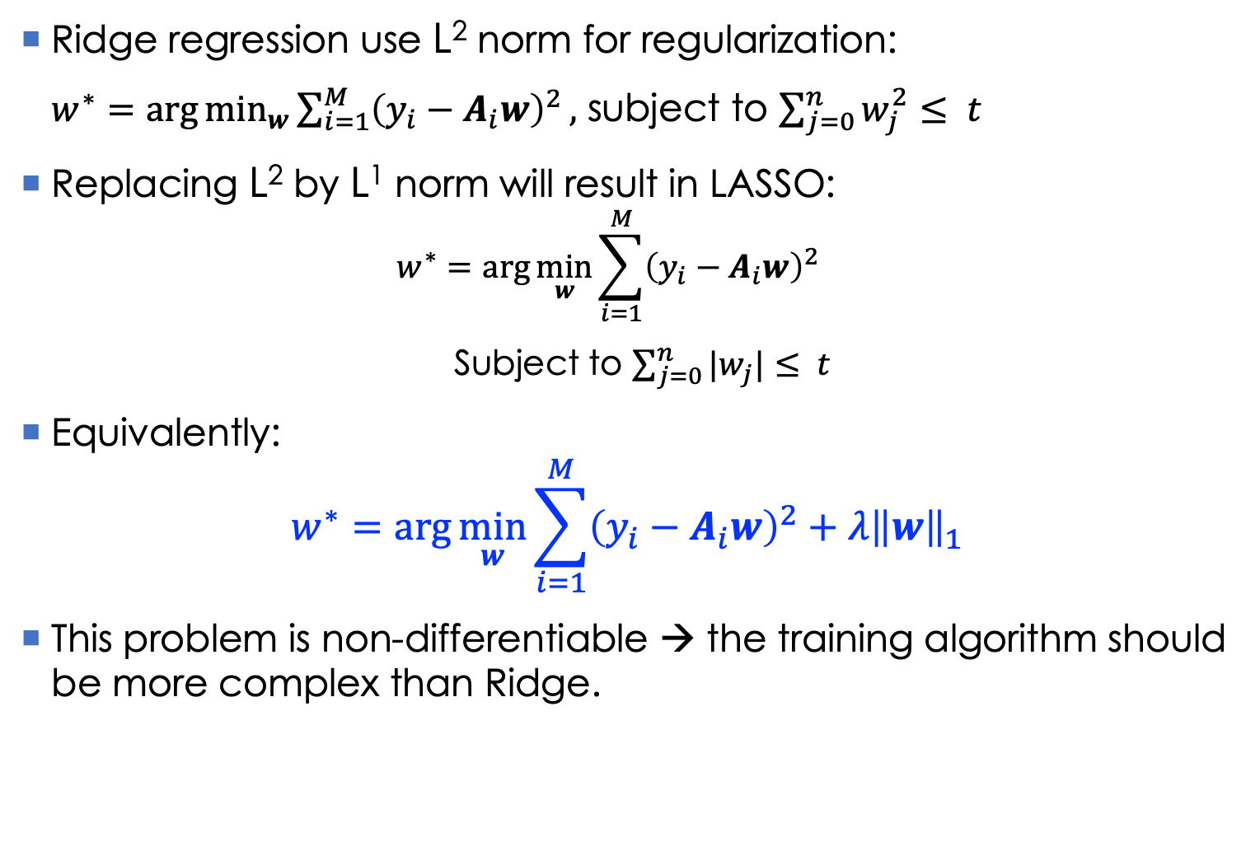
LASSO
Ridge regression use L² norm for regularization:
$w^{∗}=\arg{\min_{w}{\sum_{i=1}^{M}{{\left(y_{i}−A_{i}w\right)}^{2}}}},$ subject to $\sum_{j=0}^{n}{w_{j}^{2}}≤ t$
Replacing L² by L¹ norm will result in LASSO:
$$w^{∗}=\arg{\min_{w}{\sum_{i=1}^{M}{{\left(y_{i}−A_{i}w\right)}^{2}}}}$$
Subject to $\sum_{j=0}^{n}{|w_{j}|}≤ t$
Equivalently:
$$w^{∗}=\arg{\min_{w}{\sum_{i=1}^{M}{{\left(y_{i}−A_{i}w\right)}^{2}}}}+λ{\left\|w\right\|}_{1}$$
This problem is non-differentiable → the training algorithm should be more complex than Ridge.
(3)
(4)

Slide 20
LASSO: regularization role
The regularization types lead to different domains for w.
LASSO often produces sparse solutions, i.e., many components of w are zero.
Shinkage and selection at the same time
Figure by Nicoguaro - Own work, CC BY 4.0, https://commons.wikimedia.org/w/index.php?curid=58258966

Slide 21
OLS, Ridge, and LASSO
The training set D contains 67 observations on prostate cancer, each was represented with 8 attributes. OLS, Ridge, and LASSO were trained from D, and then predicted 30 new observations.
w | Ordinary Least Squares | Ridge | LASSO
0 | 2.465 | 2.452 | 2.468
lcavol | 0.680 | 0.420 | 0.533
lweight | 0.263 | 0.238 | 0.169
age | −0.141 | −0.046
lbph | 0.210 | 0.162 | 0.002
svi | 0.305 | 0.227 | 0.094
lcp | −0.288 | 0.000
gleason | −0.021 | 0.040
pgg45 | 0.267 | 0.133
Test RSS | 0.521 | 0.492 | 0.479
Some weights are 0 → some attributes may not be important

Slide 22
References
Trevor Hastie, Robert Tibshirani, Jerome Friedman. The Elements of Statistical Learning. Springer, 2009.
Tibshirani, Robert (1996). "Regression Shrinkage and Selection via the lasso". Journal of the Royal Statistical Society. Series B (methodological). Wiley. 58 (1): 267–88.

Slide 23
Exercises
Derive the solution of (1) and (2) in details.
Derive the solution of (2) when removing w₀ from the penalty term.

